Slide 1


Telecom Retention
A new Perspective of Business
Akanksha Singh

Slide 2

Telecom Sector
The telecommunication sector is made up of companies that make communication possible on a global scale, whether it is through the phone or the Internet, through airwaves or cables, through wires or wirelessly. These companies created the infrastructure that allows data in words, voice, audio, or video to be sent anywhere in the world. The largest companies in the sector are telephone (both wired and wireless) operators, satellite companies, cable companies, and Internet service providers.

Slide 3

Challenges in the Telecom Industry
The Need for Quick and Personalized Customer Service
Complex Operational Processes
Network Security
Leverage over-the-top players
Customer Retention
Customer acquistion

Slide 4

Retention
Retention refers to the activities and actions companies and organizations take to reduce the number of customer defections.
The goal of customer retention programs is to help companies retain as many customers as possible, often through customer loyalty and brand loyalty initiatives. It is important to remember that customer retention begins with the first contact a customer has with a company and continues throughout the entire lifetime of the relationship.

Slide 5
Customer Churing Rate
When customer leave to use particular services then we can said customer is going to churn.
Customer churn gives us idea ,how are we going with our product and services.
Customer retention and customer churning rate have inversely proportional relationship.
When we spot why customer are churning then we can improve customer retention.
Every telecoms provider knows that it is much cheaper to retain an existing customer than it is to acquire a new one.

Slide 6

Four Churn Segments
Conditionally Loyal Subscriber
Conditional Churner
Lifestyle Churner
Unsatisfied Churner

Slide 7
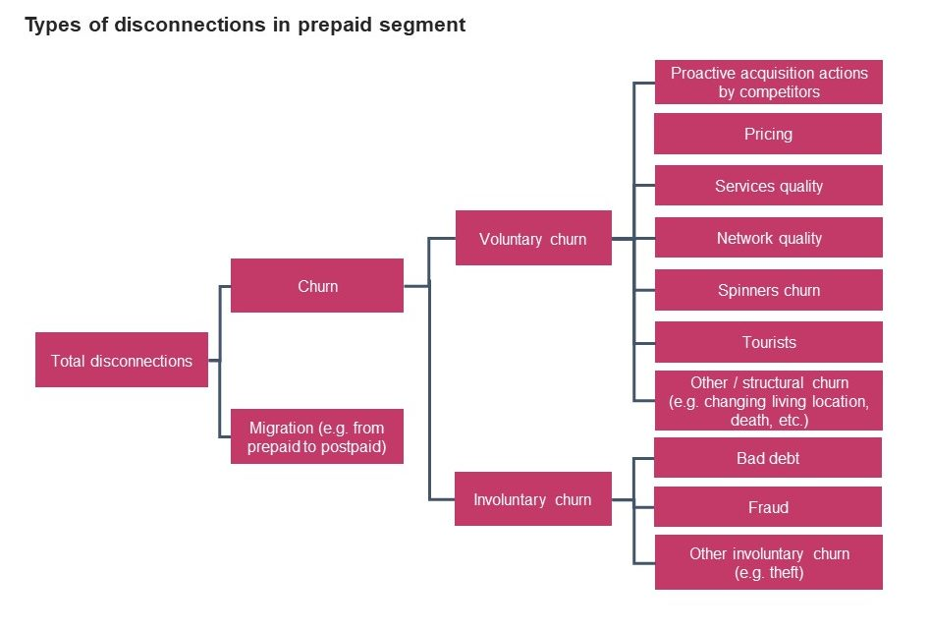
Key Drivers that influence churn
Handset Loss/Upgrade
Cost of Service / Competitor Pricing
Network Quality
Customer Care Quality

Slide 8
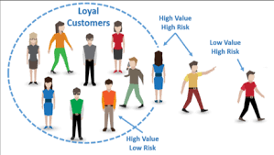
Key drivers for subscriber loyalty
Offers and services
Price
Quality of Products and services
Quality of products and services
Length of contract period
Perception of telecom brand
Marketing programmes and campaigns

Slide 9
Aspects of a Customer Retention Strategy That Can’t be Overlooked
Define what you mean by churn – according to you who are churners.
Segment your customer base to build a more accurate profile of your users
Segment your customer base to build a more accurate profile of your users
Innovate and shout about your differentiating qualities
. Focus on what your customers really care about
Re-vamp your loyalty programmes
Ensure proper front-line training and materials
Pilot your retention strategies before rolling out
Throw out the rule book

Slide 10
How data science useful in customer retention ?
Data Science Predicts Customer Behavior So You Can Target Critical Segments.
data science tools have transformed the segmentation process from an Excel exercise into a futuristic prediction machine.
Classify Frequent Users But perhaps the greatest way AI and ML come to the rescue in retention efforts is by automating the segmentation process and pointing out:
Which users need critical attention so they don’t churn
Which users are unlikely to convert (so you can save your campaign dollars)
Data Science Gives You Real-Time Insights to Drive Relationship Marketing
Personalize Down to Likes, Dislikes

Slide 11
Project Insights
Significant features which impact customer retention are tenture, contract_month_to_month, Total_charges, tenture_group_1-12, Contract_two_year, Monthly charges.
Customer churn who uses elctronic payment method.
Senior citizens are lessly to churn.
Contract Type - Monthly customer are morelikely to churn because of no contract terms, as they are free to go customer.
No Online security.No Tech Support category are high churners.
Low Churn seen in case of Long term contracts, Subsciptions without internet service and The customers engaged for 5+ years.

Slide 12
Conclusion
Significant variables impacting “Churn”: Type & Tenure of Contract
Churn is observed to be high for customers:
Without dependents
With high cost Phone Services
Having single line service (no combo services)
Recommendation to Business Team for retaining Customer
Targeted Customer Promotion
Promote Long Term contract
Market more products as Combo (multi) service offerings

Slide 13
THANKYOU

